Slide 1

AZERBAIJAN STATE OIL AND INDUSTRY UNIVERSITY
FACULTY:ITIF
GROUP:604.20E
SUBJECT:PHYSICS
TEACHER:XURAMAN AHMADOVA
STUDENT:GUNEL HUMBATOVA

Slide 2
TOPIC
Macro and microstates. The statistical weight. Entropy. The law of entropy increase.

Slide 3
Plan:
About macro and microstates
The statistical weight
What is Entropy? With example
The law of entropy increase.
Second law of thermodynamics.

Slide 4
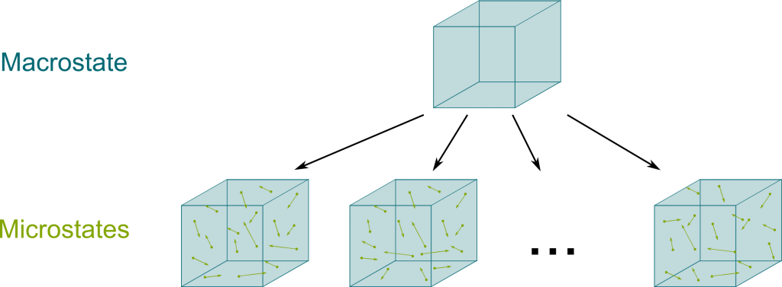

Macro and microstates.
The key difference between microstate and macrostate is that microstate refers to the microscopic configuration of a thermodynamic system, whereas macrostate refers to the macroscopic properties of a thermodynamic system.
Notes:
In physics, a microstate is defined as the arrangement of each molecule in the system at a single instant.
A macrostate is defined by the macroscopic properties of the system, such as temperature, pressure, volume, etc.
For each macrostate, there are many microstates which result in the same macrostate.

Slide 5
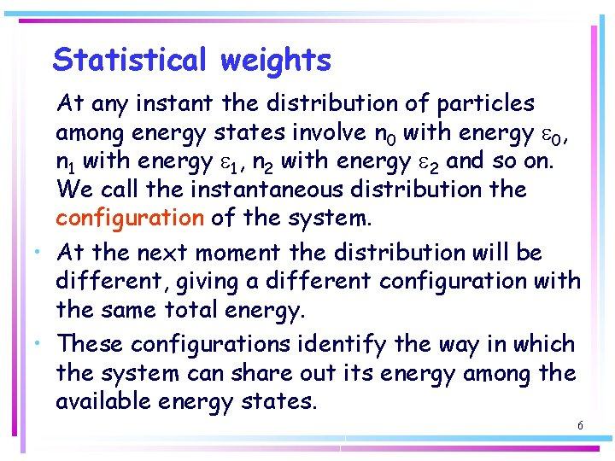
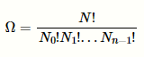
The statistical weight.
If the energy associated with the feature is ΔE, the statistical weight is given by the Boltzmann factor e^{−ΔE/k}_{B}^{T}, where k_{B} is the Boltzmann constant and T is the temperature in kelvins.
The statistical weight is a convenient shorthand that is often used in transfer matrix solutions of problems in statistical mechanics.
In statistical mechanics, we always seek the number of microstates corresponding to a given macrostate (N, V, U). It is called the thermodynamic probability or the statistical weight of the macrostate and is denoted by Ω(N,V,U). This variable is related to the thermodynamic variable entropy S. You will observe that the relation between the entropy S and the thermodynamic probability Ω forms the basis of entire statistical analysis.
Notes:
In statistical mechanics, the statistical weight is the relative probability of a particular feature of a state.
It refers to the configuration entropy of a system. The configuration is the instantaneous arrangement of all the
particles of the system throughout the distinct energy levels of the system.
The macrostate of the system will reflect those configurations of the particles which are more likely; we assume that the probability of a particle being at each level is equal. It is denoted Ω which can also be referred to as multiplicity and is the tenet of entropy. where N is the total number of particles and n the number of particles in any one of the energy levels available. The weight relates the microstate to the number of ways particles can be arranged to match the macrostate (T, V, P) it expresses the nanoscopic in the scale of our reality.

Slide 6

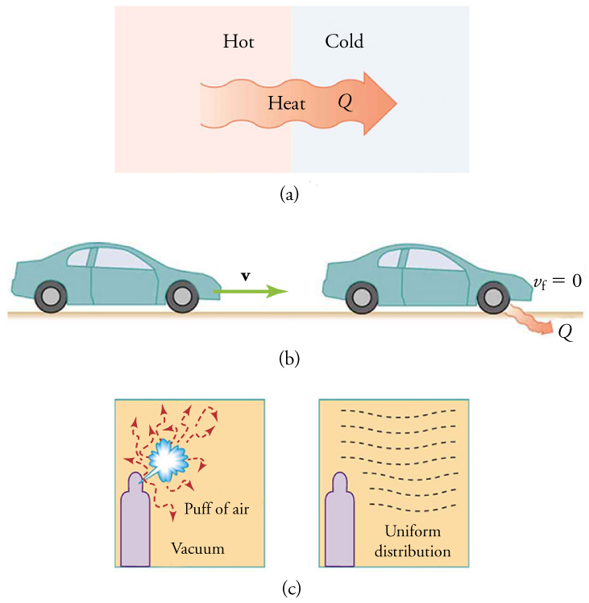
Entropy. What is entropy in simple terms?
The entropy of an object is a measure of the amount of energy which is unavailable to do work.
Entropy is also a measure of the number of possible arrangements the atoms in a system can have.
In this sense, entropy is a measure of uncertainty or randomness.
Is entropy a law of physics?
The second law of thermodynamics states that the total entropy of a system either increases or
remains constant in any spontaneous process; it never decreases. ... Heat cannot transfer energy spontaneously
from colder to hotter, because the entropy of the overall system would decrease.

Slide 7
What is entropy explain with example?
Let’s start with a puzzle.
Why does this gif look totally normal...
...but this one look strange?
The second gif is just the first one played in reverse. But something about it immediately seems off. This just never happens. Ice melts on a warm day, but a glass of water left out will never morph into neatly-stacked cubes of ice.
Notes:
Imagine you dropped an egg on the floor. Every atomic motion taking place in this messy event could have happened in reverse. The pieces of the egg could theoretically start on the floor, hurtle towards each other, reforming into an egg as it lifts off the ground, travel up through the air, and arrive gently in your hand. The movement of every atom in this time-reversed egg would still be perfectly consistent with the laws of physics. And yet, this never happens.
At this point, you might be wondering what this has to do with entropy. Well, entropy is just a fancy word for ‘number of possible arrangements’. Entropy is a count of how many ways you can rearrange the ‘insides’ of a thing (its microscopic internals), while keeping its ‘outwardly’ (macroscopic) state unchanged. (Technically it’s the log of the number of these arrangements, but that’s just a mathematical convenience and doesn’t affect our discussion.)

Slide 8
The law of entropy increase.
Although all forms of energy can be used to do work, it is not possible to use the entire available energy for work.
Consequently, not all energy transferred by heat can be converted into work, and some of it is lost in the form of waste heat—that is, heat that does not go toward doing work. The unavailability of energy is important in thermodynamics; in fact, the field originated from efforts to convert heat to work, as is done by engines.
Notes:
This phenomenon is explained by the second law of thermodynamics, which relies on a concept known as entropy.
Entropy is a measure of the disorder of a system. Entropy also describes how much energy is not available to do work.
The more disordered a system and higher the entropy, the less of a system's energy is available to do work.

Slide 9
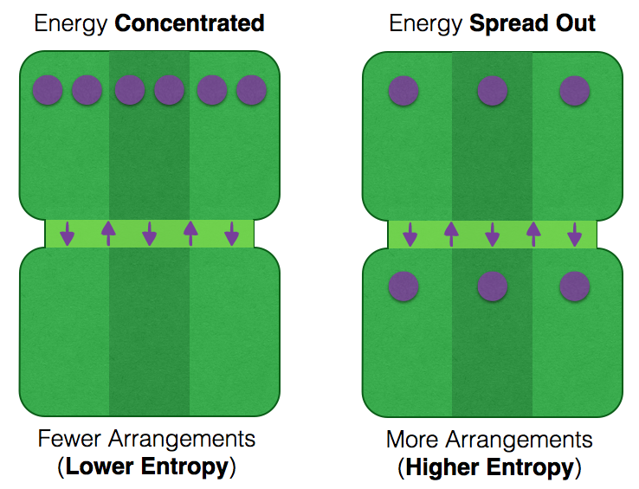
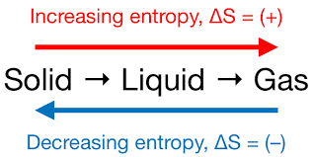
The equation for the change in entropy
ΔS, is
ΔS=Q/T, where Q is the heat that transfers energy during a process,
and T is the absolute temperature at which the process takes place.
Notes:
The second law of thermodynamics states that the total entropy of a system either increases or remains constant in any spontaneous process; it never decreases. An important implication of this law is that heat transfers energy spontaneously from higher- to lower-temperature objects, but never spontaneously in the reverse direction.
This is because entropy increases for heat transfer of energy from hot to cold

Slide 10
Sources:
https://openstax.org/books/physics/pages/12-3-second-law-of-thermodynamics-entropy
https://physics.stackexchange.com/questions/469948/what-is-the-statisitical-weight-of-a-system
https://aatishb.com/entropy/
1
3
5
2
4
6
https://physics.stackexchange.com/questions/469948/what-is-the-statisitical-weight-of-a-system
https://openstax.org/books/physics/pages/12-3-second-law-of-thermodynamics-entropy
https://www.sciencedirect.com/topics/computer-science/statistical-weight

Slide 11
THANKS!
Any questions?
You can find me at:
guneljh@code.edu.az

